Slide 1
How DOES it work?
Technical reading, W2

Slide 2
Outline
Process description
Simple process as a sequence of steps
System architecture
Data flow in data processing
Non-sequential flow
UML activity diagram
UML sequence diagram

Slide 3
Describing a Process
A process is a series of events or actions that occur over time to accomplish something.
To describe how something works in a process,
Identify the interacting components / agents
Describe the order that data/command flow among the components
Explain processing done at components
Step-by-step approach
each step/phase/stage in a process should be discussed separately following the sequence / time order
usually a figure is essential in explanation
Notes:
https://www.slideshare.net/jenlag/technical-writing-1-39084267

Slide 4
Example: instruction cycle
Read the article “1-instruction cycle.docx”
What are the interacting components?
What is the purpose of this process?
For each step,
What data is moved?
What processing is done?
What features of the computer hardware are used?
Notice how the figure helps you to understand the process

Slide 5
System Architecture
System architecture provides a high-level explanation of how the systems work
A system architecture
specifies the main components in a system
explains how the components work together to achieve the main tasks
specifies the data / command sent between the components
describes the order of the events or actions done in the system

Slide 6
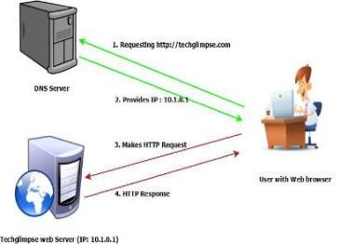
Example 1, System architecture
Domain Name System (DNS) is an industry standard protocol that translates domain name to IP address and vice versa. The following diagram shows how DNS works in web browsing. The user makes a request to techglimpse.com and the browser asks DNS for techglimpse’s IP address to make HTTP request. Once the DNS returns the IP address, the web browser makes HTTP request and the web server responds to the browser.
Credit: https://techglimpse.com/dns-tutorials-types-name-servers-basics/
Notes:
https://techglimpse.com/dns-tutorials-types-name-servers-basics/

Slide 7
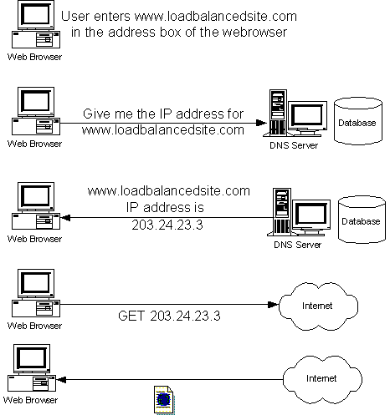
Example 2, System architecture
When you enter a URL in a browser, the browser sends a request to the DNS asking it to return the IP address of the site. This is called the DNS lookup. After the Web browser gets the IP address for that site, it contacts the site using the IP address, and displays the page for you.
Credit: http://www.onjava.com/pub/a/onjava/2001/09/26/load.html
Notes:
http://www.onjava.com/pub/a/onjava/2001/09/26/load.html

Slide 8
Expressing order, 1
Time clauses are used to show the order of events
e.g. after, before, when, while, first, second, third, after, next, later
Ref:
https://dictionary.cambridge.org/grammar/british-grammar/linking-words-and-expressions/conjunctions-time

Slide 9
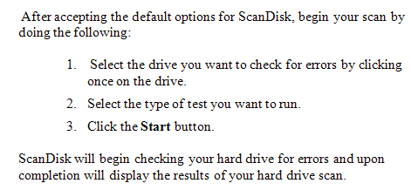
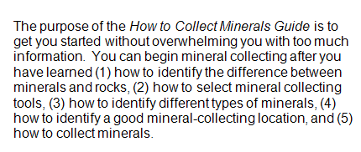
Expressing order, 2
Numbered list and in-sentence list put more emphasis on the sequence.
Ref: https://www.prismnet.com/~hcexres/textbook/lists.html

Slide 10
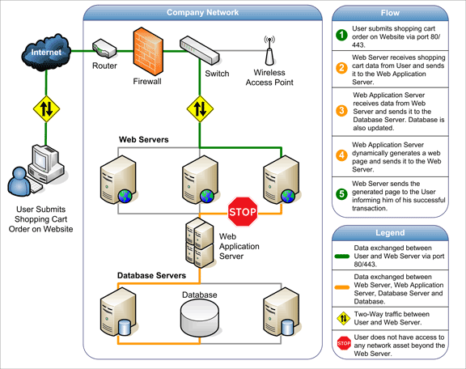
Example 3, Architecture Of A Web App
Notes:
https://www.quora.com/What-is-a-web-app-and-how-does-it-work-Please-explain-what-it-is-how-it-works-architecture-wise-and-whatever-else-you-think-is-important-and-in-which-way-it-is-different-than-the-previous-way-of-doing-things

Slide 11
Adding more information to process description
If the components are not familiar to readers, explain them before describing the process
For each step, if necessary, also describe
Where the step occurs
How it works (e.g. breakdown into finer steps, principle, mathematical model, algorithm)
Purpose of the step (i.e. why?)
For data processing step, indicate the input, output, and the processing/transformation done

Slide 12
Exercise 1, FYP poster
Read the process description in “2-poster-slot performance.pdf”
System components
(optional) algorithms
Answer the following:
What methods did the author use to describe the order of steps?
What words are used to indicate order?
Are all the steps done strictly sequentially?
Point out explanation for unfamiliar components
Point out purposes for some steps

Slide 13
Long description of process
Introduction
Definition of the process, why is it important, overview of the steps of phases
For each step in 1..N
Definition or overview (in topic sentence)
Input, output, processing
Events occurring in the step
Causes & effects related to these events
Conclusion
Discuss the causes & effects of the whole process
Describe the end results produced

Slide 14
Reference
Technical Writing: Process Writing https://www.slideshare.net/jenlag/technical-writing-1-39084267
Description of a process https://www.slideshare.net/JourdanIsaacTanaleon/description-of-a-process
Process discussion https://www.prismnet.com/~hcexres/textbook/proc.html

Slide 15
Understanding non-sequential processes
Most processes in computing are not sequential
Advanced features:
Decision / branch
Repetition / loop
Concurrency
Common diagrams to describe such processes
Flow chart
UML activity diagram
UML sequence diagram
Don’t just include a diagram. Write to help readers read the flow. Highlight the characteristics.

Slide 16
Data flow
Instead of explaining a process w.r.t. interacting components, we can also focus on data flowing through processing actions.
The data flow in “3-data flow-slot analysis.pdf” uses a UML activity diagram to explain data processing
Notice the notation for Activity, Data and Flow
Also notice how the author explains the action performed

Slide 17
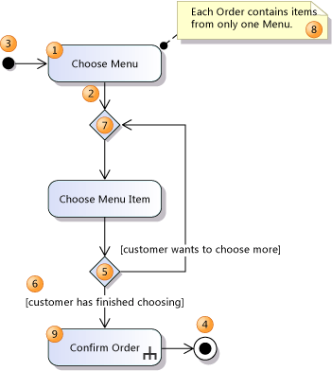
A quick lesson on UML activity diagram
Action, Control flow, Decision node
Initial node, final node
To read a diagram, imagine that a token, or thread of control, passes along the flow from one action to another
Credit: https://msdn.microsoft.com/en-us/library/dd409360.aspx
Notes:
https://msdn.microsoft.com/en-us/library/dd409360.aspx

Slide 18
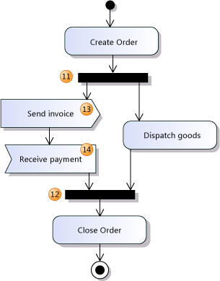
A quick lesson on UML activity diagram
Fork node divides a single flow into concurrent flow
Join node combines concurrent flows into a single flow
Send signal action sends a message or signal
Accept event action waits for a message or signal before the action can continue
Notes:
https://msdn.microsoft.com/en-us/library/dd409360.aspx

Slide 19
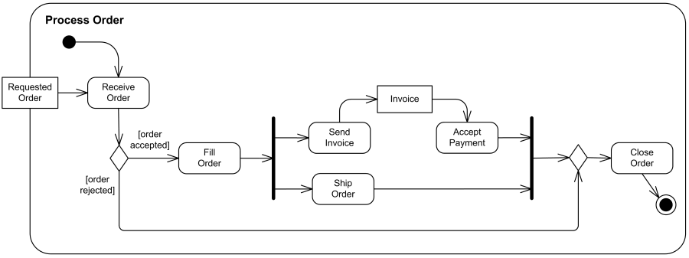
Example 4, Order processing
Requested order is input parameter of the activity. After order is accepted and all required information is filled in, payment is accepted and order is shipped. Note that this business flow allows order shipment before invoice is sent or payment is confirmed.
Credit: https://www.uml-diagrams.org
Notes:
https://www.uml-diagrams.org/shopping-process-order-uml-activity-diagram-example.html?context=activity-examples

Slide 20
Example 5, two threads
To achieve this, the mobile application has two thread actions, as shown in Figure X. The first action is to periodically inquire the geolocation API of the mobile phone to find the current location of the user. The other is to get the current parking data from the front line server, filter the nearby parking lots, and present the data on the map view. Furthermore, the mobile application will poll the front line server in a period of 30 seconds.

Slide 21
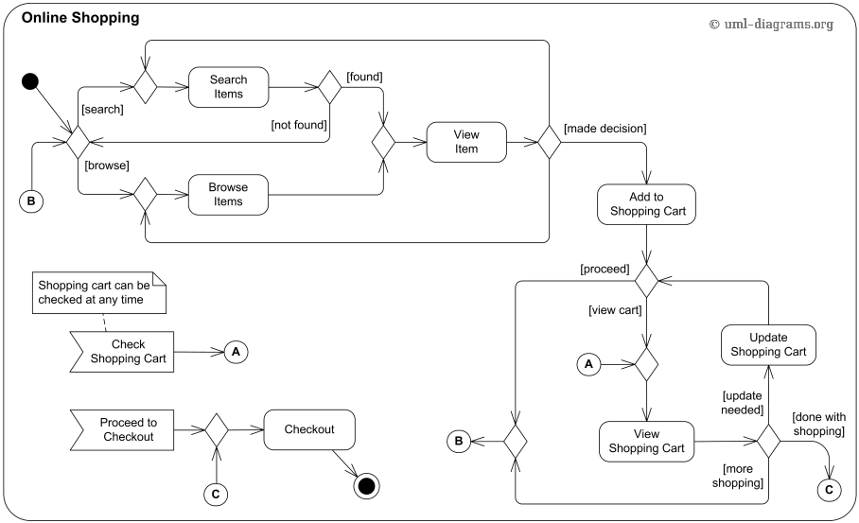
Example 6, Online shopping
Exercise: write a paragraph to summarize the flow
Notes:
https://www.uml-diagrams.org/activity-diagrams-examples.html

Slide 22
Tutorials on UML activity diagram
https://msdn.microsoft.com/en-us/library/dd409360.aspx
http://www.inf.ed.ac.uk/teaching/courses/seoc/2011_2012/notes/

Slide 23
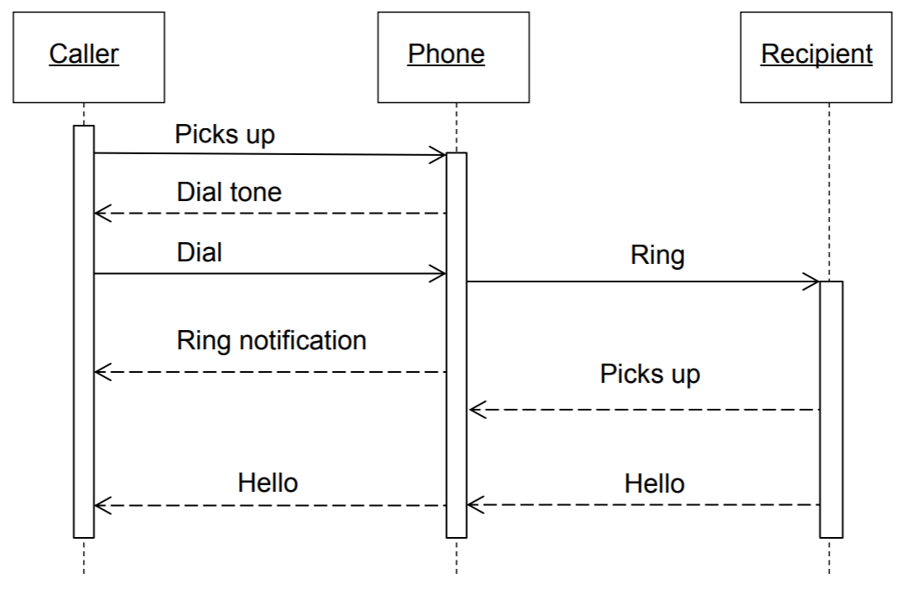
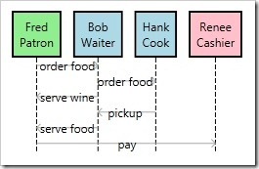
A quick lesson on UML sequence diagram
Participants: objects that interact to complete sth
Time: vertical axis
Messages: communication between participants
Notes:
http://csis.pace.edu/~marchese/CS389/L9/Sequence%20Diagram%20Tutorial.pdf

Slide 24
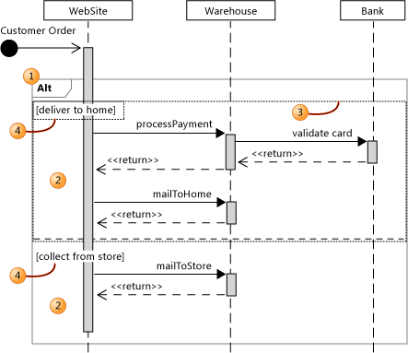
A quick lesson on sequence diagram
Combined fragments let you show loops, branches and other alternatives
In this example, there is different sequence of events for the two cases: [deliver to home] and [collect from store]
Notes:
https://creately.com/blog/diagrams/sequence-diagram-tutorial/

Slide 25
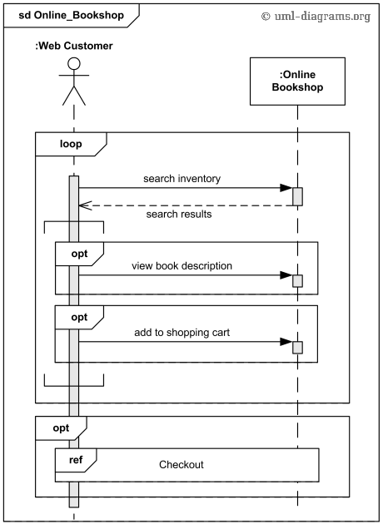
Example 7, online bookshop
A customer searches the inventory for some book
He may view detail description
After that, he may add the book to the shopping cart
After that, he may checkout all books in the shopping cart. For detail, refer to another sequence diagram
The customer can repeat the above steps

Slide 26
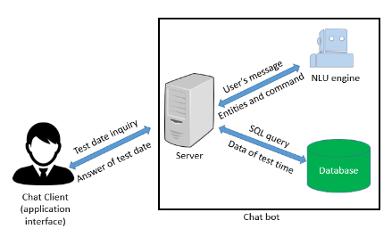
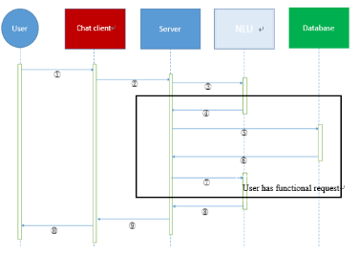
Exercise, sequence diagram
Read 5-chatbot system architecture.pdf
The excerpt contains the system architecture and sequence diagram that explains the interaction between the system components
Comment on the explanation

Slide 27
Tutorials on UML sequence diagram
https://courses.cs.washington.edu/courses/cse403/15sp/lectures/L10.pdf
https://creately.com/blog/diagrams/sequence-diagram-tutorial/
https://www.uml-diagrams.org/sequence-diagrams-examples.html
https://www.uml-diagrams.org/sequence-diagrams-combined-fragment.html
Notes:
http://trelford.com/blog/post/UML-Sequence-Diagram-F-Script.aspx

